Slide 1
WayneBuy Contracts+ Training Guide
Office of Contract Management

Slide 2
NOTICE
Signed contracts that have been sent to the Office of Contract Management (OCM) are stored in the WayneBuy contracting module, WayneBuy Contracts+. If the OCM is not in possession of a contract, it has likely not been entered into WayneBuy Contracts+.
All contracts are not equally accessible to all people; the ability to view a contract is connected to Banner permissions related to an individual’s job classification, and to WayneBuy Contracts+ Workgroup rules. To find out more about your WayneBuy Contracts+ permissions, please contact the Procurement department.
This Training Guide outlines for accessing a fully-signed contract within the Workgroup to which you have been assigned.

Slide 3
FINDING WAYNEBUY CONTRACTS+
Login to WayneBuy (buy.wayne.edu)
Navigate to the Contracts Menu by hovering over the “Contracts” link to the left of the screen
Note: Some user preferences have the title of the left menu links hidden and only icons displayed. WayneBuy Contracts+ is the award icon.

Slide 4
Your Dashboard
Your Dashboard is where a summary of all the University contracts are. While you may see the name and number of a contract, you may not be able to view details of a contract unless you are a manager or a stakeholder for that contract.

Slide 5
YOUR DASHBOARD - Contract Alerts
Here you are able to filter through various alerts that a particular contract may be close to or already occurred. (Example: Expiring contracts, Recently expired contracts, and Renewing contracts)

Slide 6
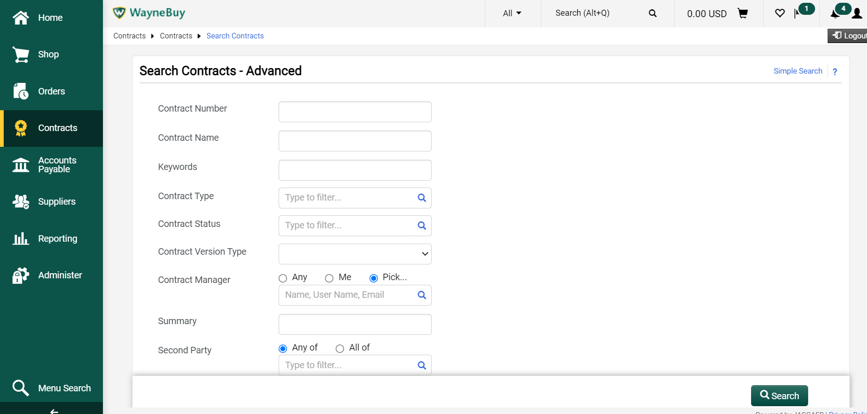
SEARCH
Quick Search
Advanced Search
type a search term in the quick search bar at the main contracts menu, or
select “search contracts” from the main contracts menu, and
type a search term and adjust the variables on the SIMPLE SEARCH SCREEN
SELECT ADVANCED SEARCH ON THE SIMPLE SEARCH SCREEN
ADJUST search termS and variables on the ADVANCED SEARCH SCREEN
*tIP: SELECT “aLL” FOR THE “ACTIVE FOR sHOPPING” VARIABLE
TO CAST THE WIDEST NET!
*tIP: WHEN YOU ARE DONE WITH YOUR SEARCH, ALWAYS CLEAR ANY VARIABLES YOU’VE ADJUSTED ON THIS SCREEN. IF YOU FORGET TO DO SO, YOUR NEXT “QUICK SEARCH” OR “SIMPLE SEARCH” MAY BE AFFECTED.

Slide 7
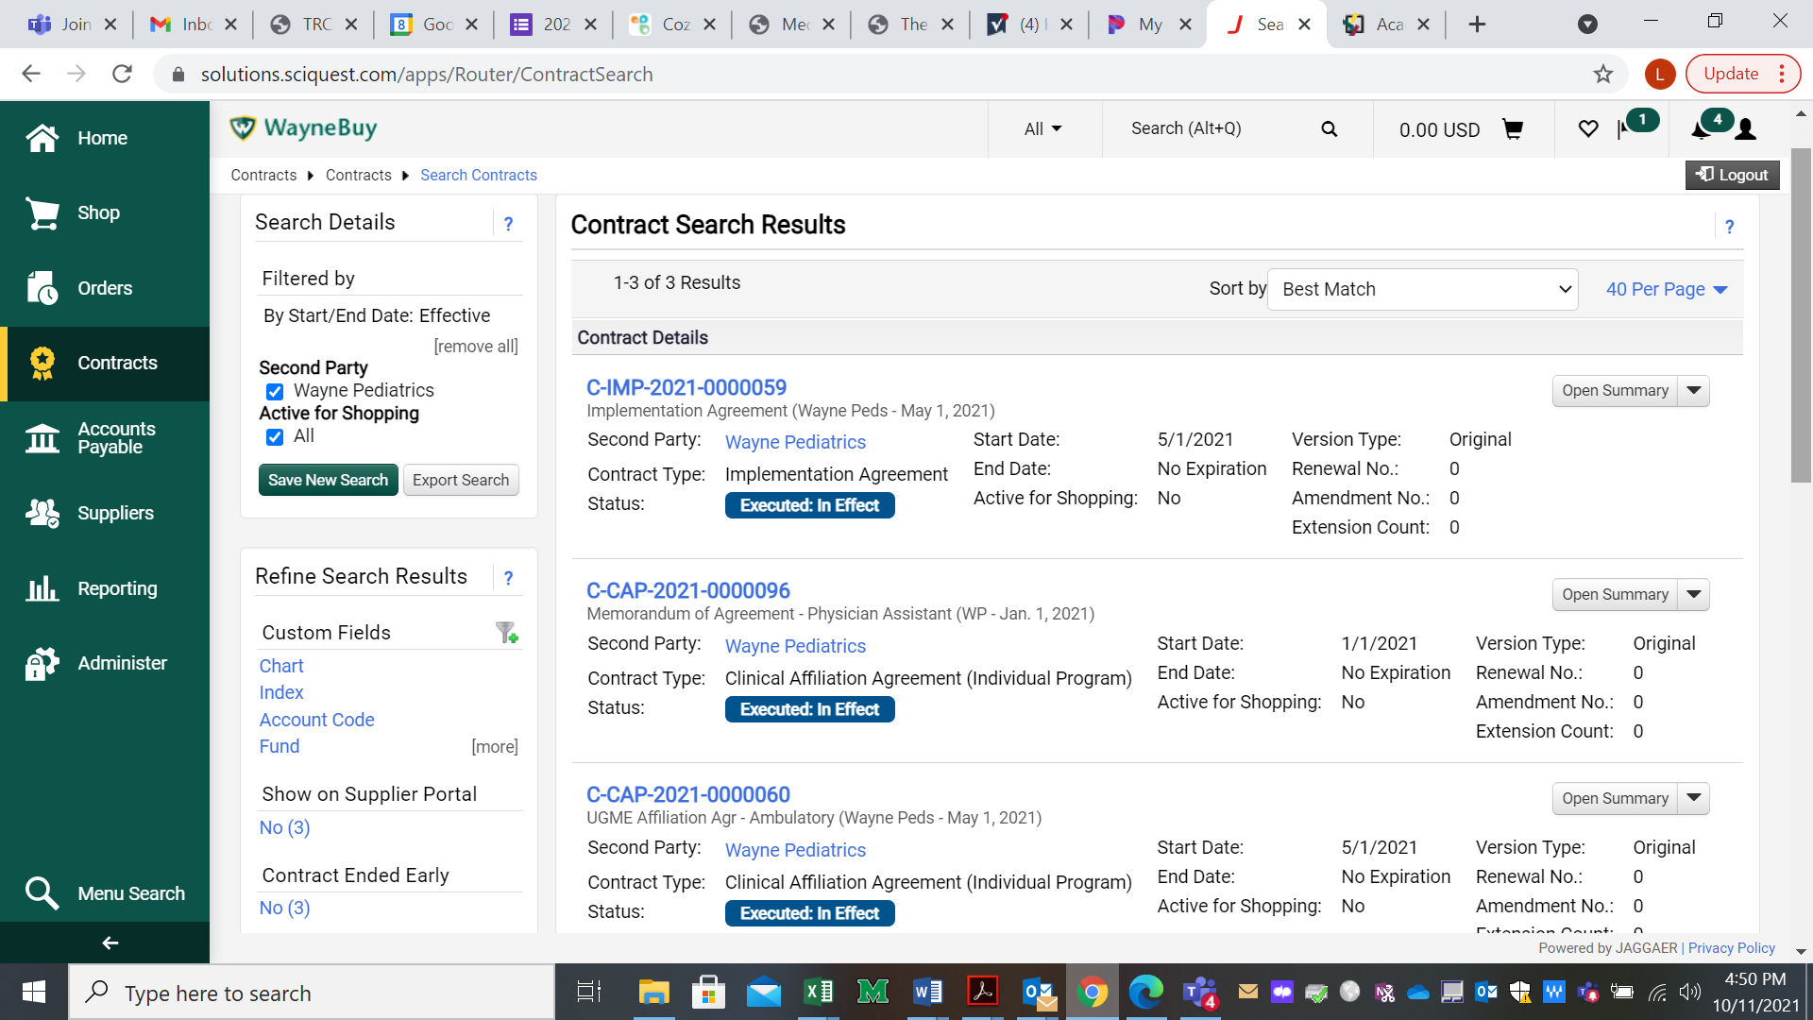
SEARCH – Results
WHEN THE SEARCH RESULTS PAGE APPEARS, CLICK THE APPLICABLE BLUE CONTRACT NUMBER TO ACCESS THE relevant CONTRACT header (summary) PAGE (pink highlight)
You will see (i) the title of the document (here, Memorandum of Agreement), (ii) additional identifying contract info (here, it’s an affiliation to allow Physician assistant students to rotate), (iii) identity of the contracting partner (here, Wayne Peds), and (iv) the effective date of the agreement (here, January 1, 2021).
*Tips
The “Second Party” is the entity with whom WSU is contracting for this entry (Green Highlight)
The name of the contract tells you a ton of information that will help you figure out which contract is the one you’re looking for! (Yellow Highlight)

Slide 8
CONTACT US
The Office of Contract Management is the centralized office for contracts. Though now, we only service the Health Affairs division of the University, we are planning for the future for our services to reach University-wide.
For questions regarding WayneBuy Contracts+, please reach out to
Eddie Dickson
Leslie Werner
Aleviyah Coles
Kenneth Doherty

